Slide 1
Food consumption vs Carbon emissions.

Slide 2
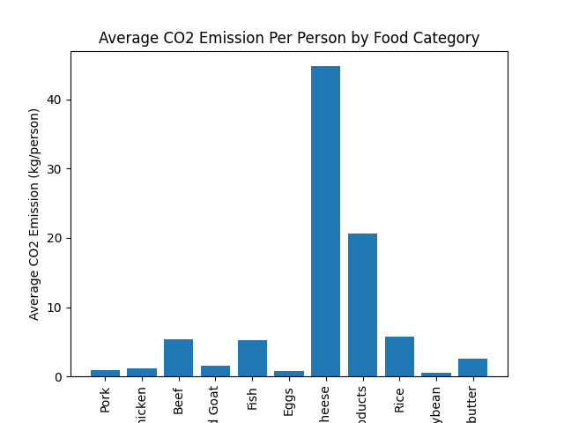
The average C02 emission per person by food category among five countries (Kenya, Uganda, Tanzania, Rwanda and Ethiopia) located in East Africa.

Slide 3
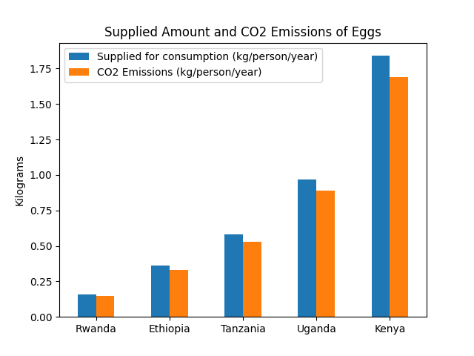
Highlight the marked difference between consumption and emissions in certain food product of your choice. (My preferred choice is eggs)

Slide 4
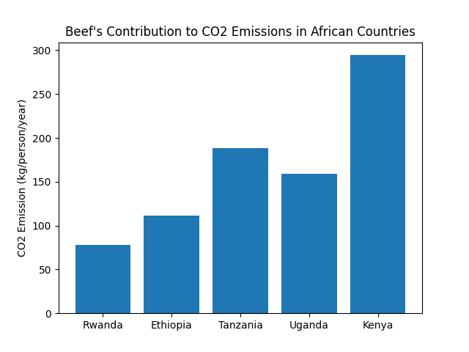
Beef's contribution to CO2 emissions (kg/person/year)

Slide 5
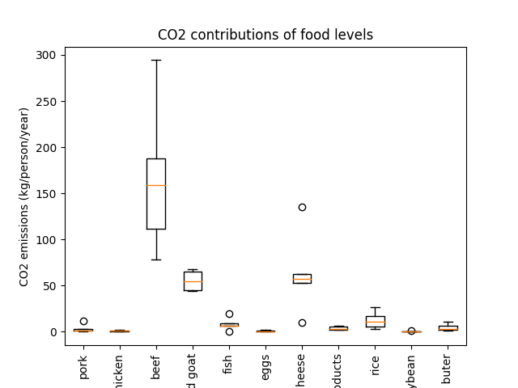
A box plot and interpretation of the CO2 contributions of food levels.

Slide 6
Interpretation
Beef has the highest median CO2 emissions across all countries, with a range from approximately 40 kg/person/year to over 280 kg/person/year.
Milk-inc. cheese and fish also have a relatively high median CO2 emissions compared to other food types.
Pork and chicken have lower median CO2 emissions than beef, milk-inc. cheese, and fish.
Nuts inc peanut butter and soybean have the lowest median CO2 emissions across all countries.

Slide 7
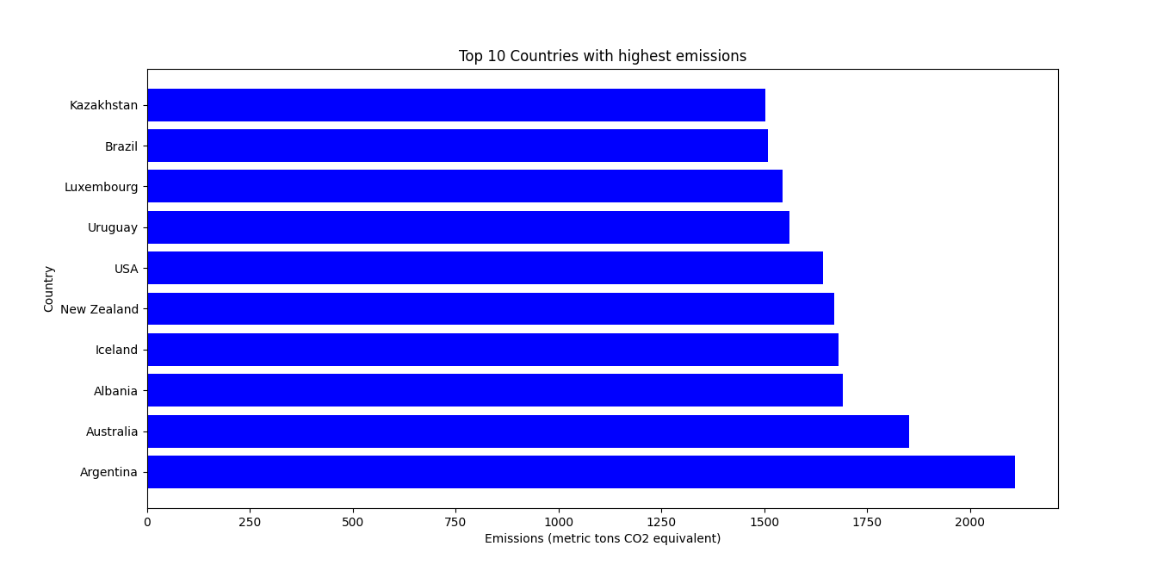
Top 10 Countries with highest emissions.
.

Slide 8
STORY BEHIND THE PLOTS
The provided dataset contains the average CO2 emissions per person by food category among different countries across the whole world. Countries in East Africa that have been included in the search are; Kenya, Uganda, Tanzania, Rwanda, and Ethiopia – where our analysis is based on. The primary objective of this analysis is to provide insights into the data and highlight the story behind the exploration, which is to find out which food has the highest carbon emission.
From the dataset, we find that the food categories that contribute most to CO2 emissions are milk products like cheese, beef and wheat and wheat products. On the other hand, food categories such as pork, chicken, and soybean have lower CO2 emissions per person. Overall, the average CO2 emission per person is higher in Kenya and Tanzania compared to the other countries.
One of the most significant observations is the marked difference between the consumption and emissions in certain food products. For example, eggs have relatively low CO2 emissions, but the amount supplied for consumption is considerably higher. The difference is evident in the bar graph, where the supplied amount is higher than the CO2 emissions.
Beef's contribution to CO2 emissions in the East African countries is also significant, with Kenya recording the highest CO2 emissions per person and Rwanda recording the lowest emission. The data is presented in a bar graph, which highlights the CO2 emissions in the five countries.

Slide 9
Furthermore, the impact of animal and non-animal food products on carbon footprint is a critical factor in the data. From the data, we find that animal products such as milk, beef, pork, and lamb and goat have a higher CO2 emission per person compared to non-animal products such as soybean, rice, nuts, and wheat products.
To provide a visual representation of the CO2 contributions of food levels, a box plot was used to show the spread of data. From the box plot, we can see that beef has a significantly higher CO2 emission per person compared to other food categories. The distribution of data is also broader for beef, indicating that there is a higher variation in CO2 emissions across the five countries.
In conclusion, the analysis of the dataset has provided valuable insights into the average CO2 emissions per person by food category in East African countries. The data highlights the significant impact of animal products on CO2 emissions, with beef and milk having the highest CO2 emissions per person. The analysis also emphasizes the need for sustainable food consumption and production practices to reduce CO2 emissions and mitigate climate change.

